Slide 1
Chapter 9
Stock Valuation
McGraw-Hill/Irwin
Copyright © 2010 by the McGraw-Hill Companies, Inc. All rights reserved.

Slide 2

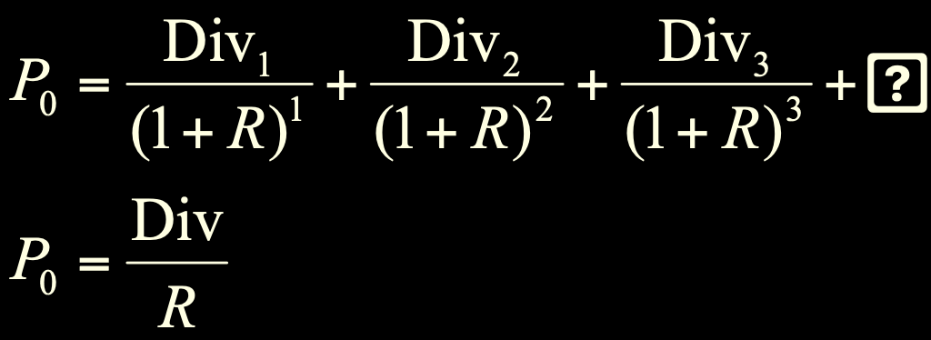
Case 1: Zero Growth
Assume that dividends will remain at the same level forever
…
Since future cash flows are constant, the value of a zero growth stock is the present value of a perpetuity:
…
…

Slide 3
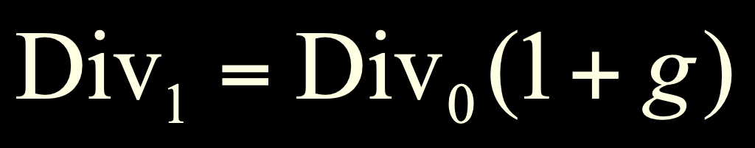
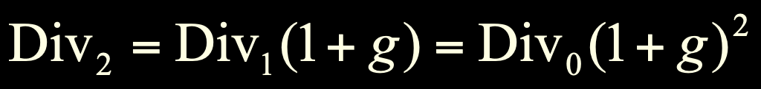
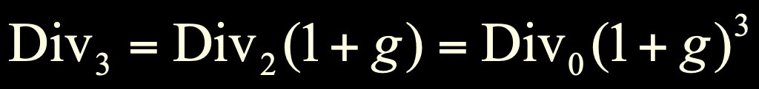
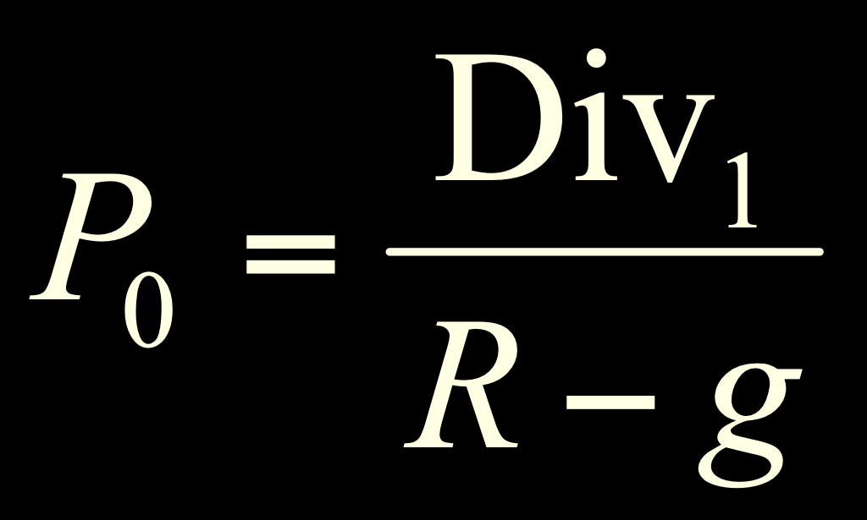
Case 2: Constant Growth
Assume that dividends will grow at a constant rate, g, forever, i.e.,
.
.
.
Since future cash flows grow at a constant rate forever, the value of a constant growth stock is the present value of a growing perpetuity:

Slide 4
Constant Growth Example
Suppose Big D, Inc., just paid a dividend of $.50. It is expected to increase its dividend by 2% per year. If the market requires a return of 15% on assets of this risk level, how much should the stock be selling for?
P₀ = .50(1+.02) / (.15 - .02) = $3.92
Notes:
The biggest mistake that students make with the DGM is using the incorrect dividend. Be sure to emphasize that we are finding a present value, so the dividend needed is the one that will be paid NEXT period, not the one that has already been paid.

Slide 5
Case 3: Differential Growth
Assume that dividends will grow at different rates in the foreseeable future and then will grow at a constant rate thereafter.
To value a Differential Growth Stock, we need to:
Estimate future dividends in the foreseeable future.
Estimate the future stock price when the stock becomes a Constant Growth Stock (case 2).
Compute the total present value of the estimated future dividends and future stock price at the appropriate discount rate.

Slide 6
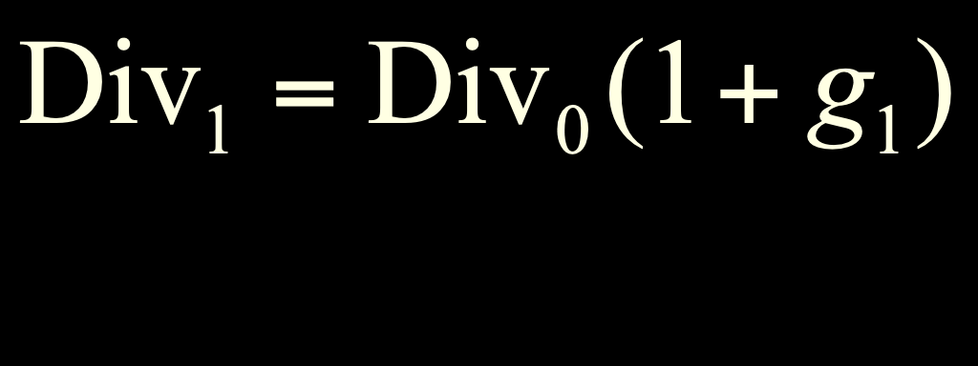
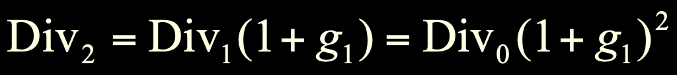

Case 3: Differential Growth
Assume that dividends will grow at rate g₁ for N years and grow at rate g₂ thereafter.
.
.
.
.
.
.

Slide 7

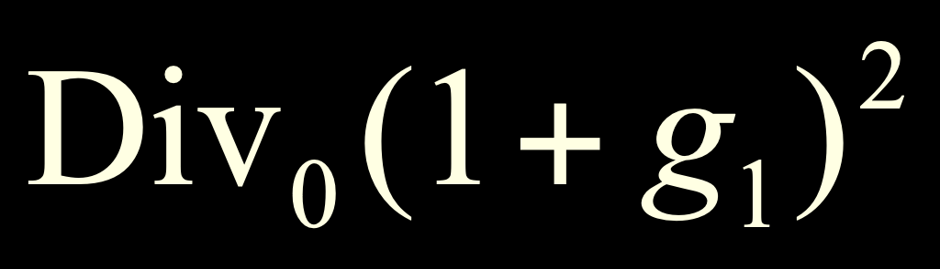
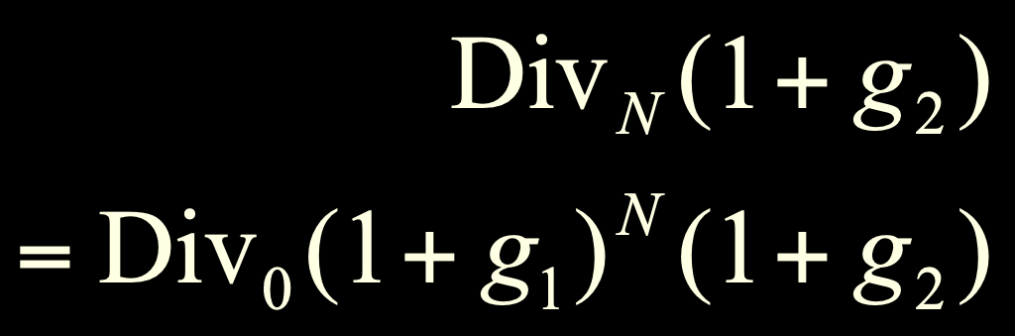

Case 3: Differential Growth
Dividends will grow at rate g₁ for N years and grow at rate g₂ thereafter
…
0 1 2
…
…
N N+1

Slide 8
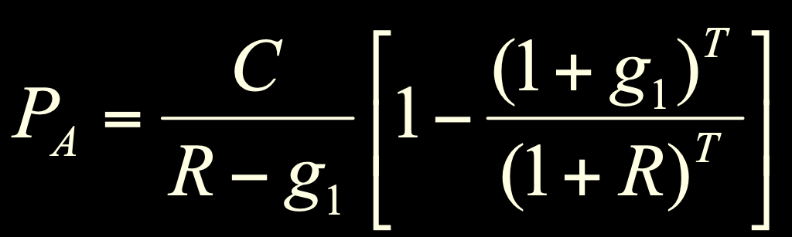
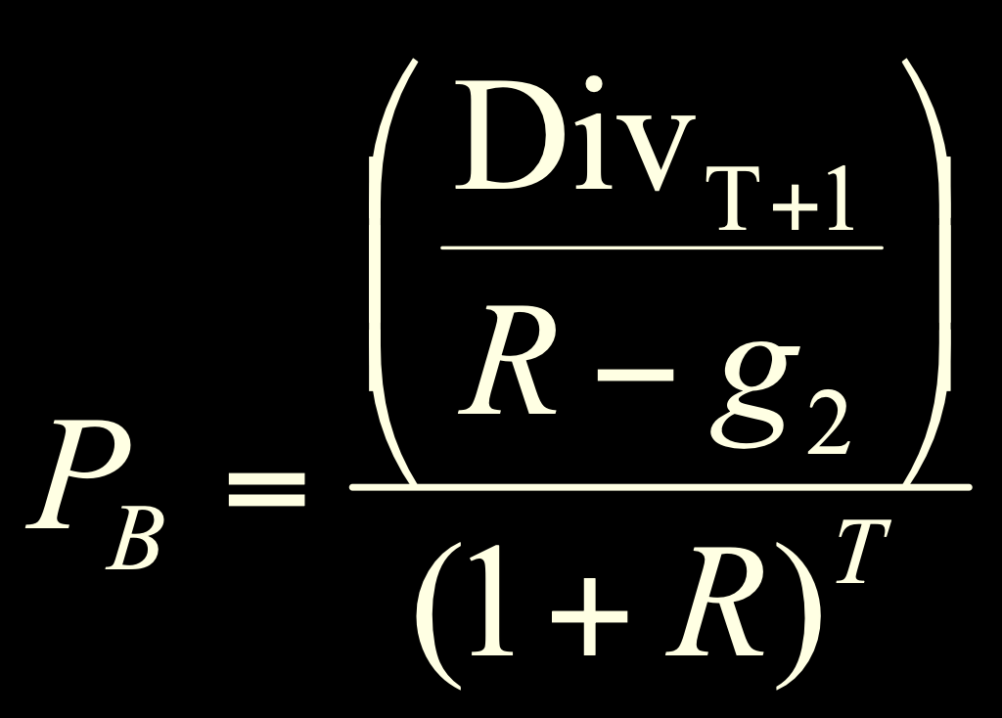
Case 3: Differential Growth
We can value this as the sum of:
a T-year annuity growing at rate g₁
plus the discounted value of a perpetuity growing at rate g₂ that starts in year T+1
Notes:
It may be good to point out that we have assumed the discount rate is constant; however, it could change across periods, or even across years.

Slide 9
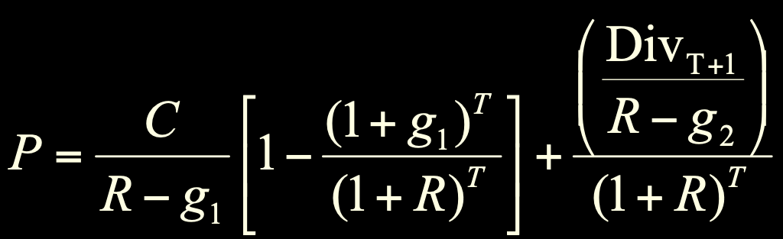
Case 3: Differential Growth
Consolidating gives:
Or, we can “cash flow” it out.

Slide 10
A Differential Growth Example
A common stock just paid a dividend of $2. The dividend is expected to grow at 8% for 3 years, then it will grow at 4% in perpetuity.
What is the stock worth? The discount rate is 12%.

Slide 11
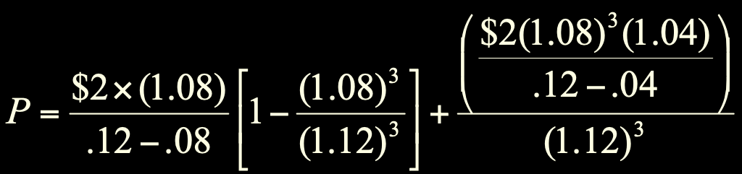
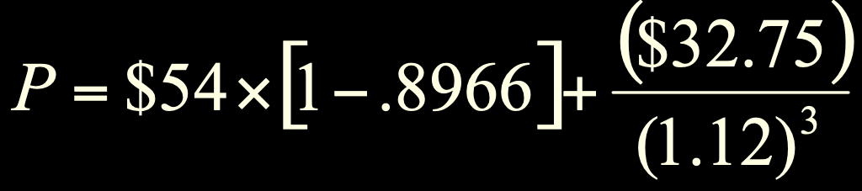
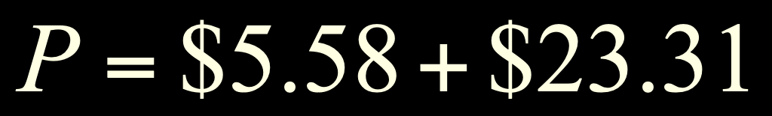
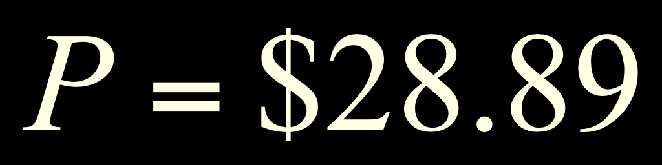
With the Formula

Slide 12
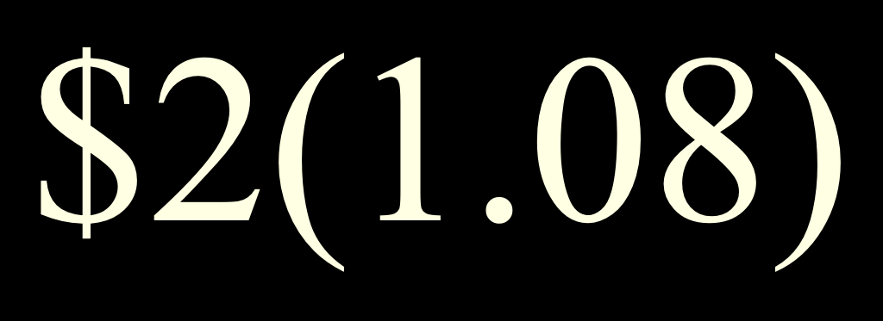
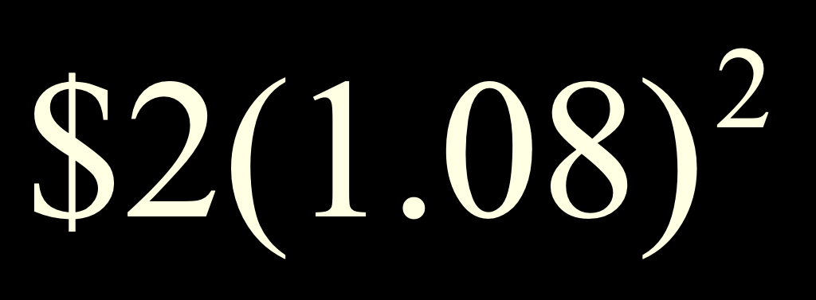
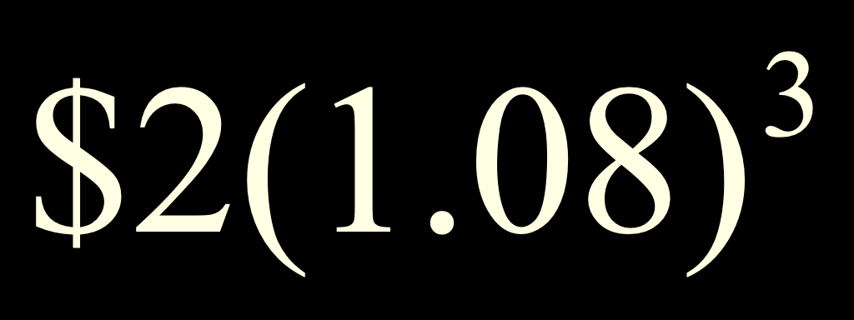

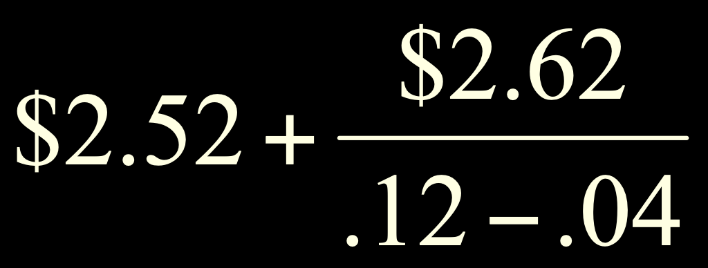
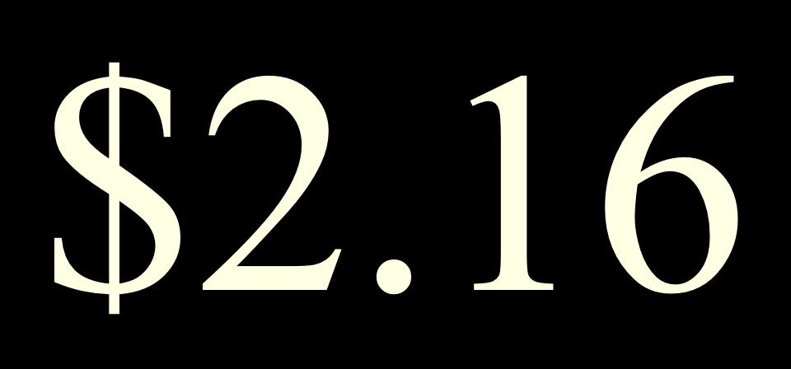

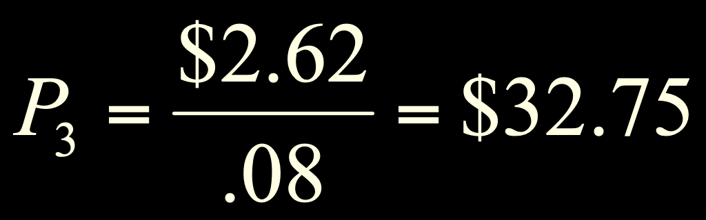
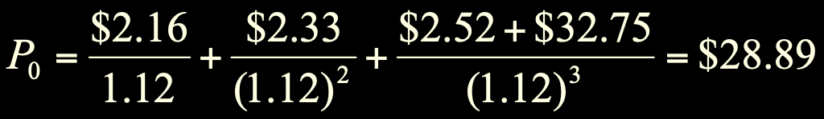
With Cash Flows
…
0 1 2 3 4
The constant growth phase beginning in year 4 can be valued as a growing perpetuity at time 3.
0 1 2 3
Notes:
This type of problem generally separates the “A” students from the rest of the class.

Slide 13
9.2 Estimates of Parameters
The value of a firm depends upon its growth rate, g, and its discount rate, R.
Where does g come from?
g = Retention ratio × Return on retained earnings

Slide 14
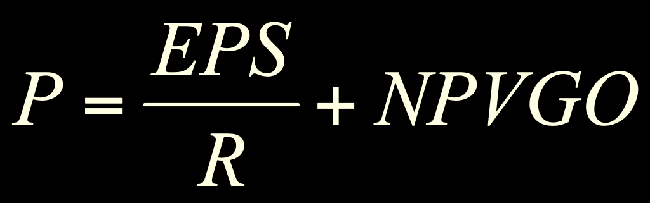
9.3 Growth Opportunities
Growth opportunities are opportunities to invest in positive NPV projects.
The value of a firm can be conceptualized as the sum of the value of a firm that pays out 100% of its earnings as dividends plus the net present value of the growth opportunities.
Notes:
A firm that pays out 100% of its earnings is essentially a zero growth firm since the retention rate is zero. This, however, does not imply the firm is not profitable.

Slide 15
Retention Rate and Firm Value
An increase in the retention rate will:
Reduce the dividend paid to shareholders
Increase the firm’s growth rate
These have offsetting influences on stock price
Which one dominates?
If ROE>R, then increased retention increases firm value since reinvested capital earns more than the cost of capital.

Slide 16

9.4 Price-Earnings Ratio
Many analysts frequently relate earnings per share to price.
The price-earnings ratio is calculated as the current stock price divided by annual EPS.
The Wall Street Journal uses last 4 quarter’s earnings

Slide 17
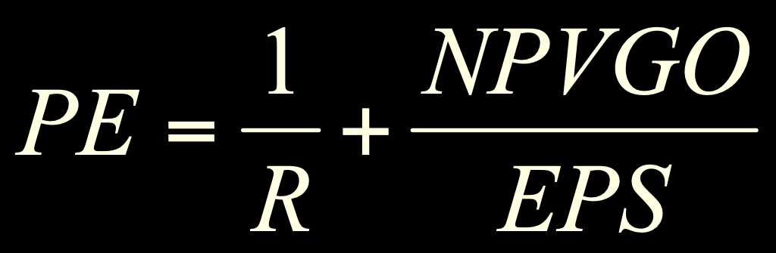
PE and NPVGO
Recall,
Dividing every term by EPS provides the following description of the PE ratio:
So, a firm’s PE ratio is positively related to growth opportunities and negatively related to risk (R)
Notes:
Accounting policies will also impact the PE ratio, as conservative policies are generally associated with higher PE ratios.

Slide 18
9.5 The Stock Markets
Dealers vs. Brokers
New York Stock Exchange (NYSE)
Largest stock market in the world
License Holders (formerly “Members”)
Entitled to buy or sell on the exchange floor
Commission brokers
Specialists
Floor brokers
Floor traders
Operations
Floor activity
Notes:
Dealer: maintains an inventory and stands ready to trade at quoted bid (price at which they will buy) and ask (price at which they will sell) prices. Make their profit from the difference between the bid and ask prices, called the bid-ask spread. The smaller the spread, the more competition and the more liquid the stock. The move to decimalization allows for a smaller bid-ask spread.
Broker: a broker matches buyers and sellers. They perform the search function for a fee (commission). They do not hold an inventory of securities.
NYSE:
Specialists manage the order flow by keeping the limit order book. The limit order book lists the trades that investors have given to their brokers that include desired trading prices. The specialist is also a dealer that holds an inventory in their assigned stock, they post bid and ask prices and they are supposed to maintain an orderly market.
Other participants on the floor of the exchange include floor traders that own exchange seats, commission brokers and floor brokers.

Slide 19
NASDAQ
Not a physical exchange – computer-based quotation system
Multiple market makers
Electronic Communications Networks
Three levels of information
Level 1 – median quotes, registered representatives
Level 2 – view quotes, brokers & dealers
Level 3 – view and update quotes, dealers only
Large portion of technology stocks
Notes:
Point out that the Nasdaq market site in Times Square is NOT an exchange. It is just offices and basically a place for reporters to report on what is happening with Nasdaq stocks.

Slide 20


Stock Market Reporting
Gap pays a dividend of 34 cents/share.
Gap has been as high as $21.89 in the last year.
Gap ended trading at $11.06, which is up 45 cents from yesterday.
Given the current price, the dividend yield is 3.1%.
8,829,800 shares traded hands in the last day’s trading.
Gap has been as low as $9.41 in the last year.
Given the current price, the PE ratio is 8 times earnings.

Slide 21
Quick Quiz
What determines the price of a share of stock?
What determines g and R in the DGM?
Decompose a stock’s price into constant growth and NPVGO values.
Discuss the importance of the PE ratio.
What are some of the major characteristics of NYSE and Nasdaq?

